Slide 1
Latinx Resource Center Overview & Dispelling Latina/e/o/x Myths and Misconceptions
Presentation by Yesenia Sanchez,
Latinx Resource Center
February 10, 2020

Slide 2
Objectives for today’s discussion:
Learn more about the LRC- who we are, our focus, programs and services to support you in connecting and referring students
Gain a better understanding of Latinx community - identifiers and demographics
Begin addressing stereotypes and biases directed towards Latinx community and how these impact students we serve
Note: The content in this presentation is simplified, due to limited time we have together. Conversations on implicit bias and its impact require extensive and ongoing discussions, and I encourage you to continue learning and expand your knowledge.

Slide 3
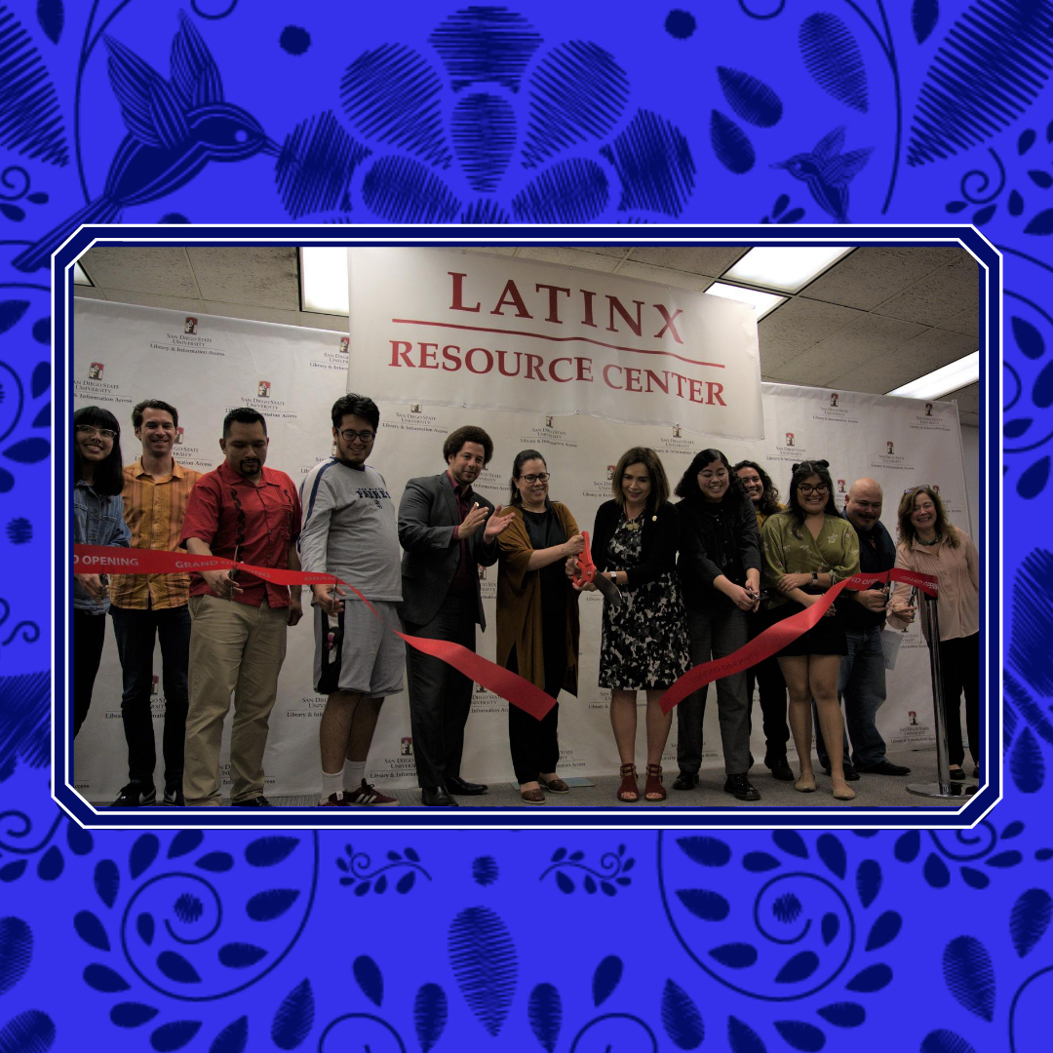
Latinx Resource Center @ SDSU
The Latinx Resource Center at SDSU supports Latinx students throughout their journey at SDSU to succeed and thrive academically, socially and mentally, with a commitment to intersectionality, inclusivity, equity and social and racial justice.
LRC launched in February 2020, and will be located inside the Love Library, next to the Chicana and Chicano Collections.
Currently, all of our programming and services are offered virtually.

Slide 4
LRC Principles
Six principles guide our work and values, our programming and how we engage as a Center:
Comunidad (Community). At the LRC, our focus is on building community, and fostering well-being across a powerful, diverse collective. We strive to think beyond the individual self, reflecting on the wellbeing of our community as a whole; on how we can give back; on how we can support others now and after graduation; on the responsibilities and connections we have to those not just at SDSU, but beyond campus as well. As a community, a colectivo, we are strong together.
Colaboración (Collaboration). At the LRC, we work together. We recognize that collaboration, among ourselves, and with those beyond our immediate community, and beyond campus, is essential to our collective progress. We recognize that all movements do, and must, include many voices, and that we can find intersubjectivity, and progress, even if we do not always fully agree. Through collaboration, we humanize one another, and move forward together.

Slide 5
Conocimientos (Knowledge). At the LRC, knowledge and learning matter. We know, following on the history of our community movements, that education is our stand. Academics can empower us. Mastering disciplinary knowledge can allow us room to challenge inequities. Pushing our intellectual boundaries in institutional contexts creates space for us to transform institutions with ours and our communities’ wisdom and knowledge. We are at SDSU to learn, and our learning will transform the world.
Confianza (Trust). At the LRC, our relationships are founded on trust; to one another, and to our communities as a whole. Though we are diverse in our views, backgrounds, experiences, and perspectives, we can build trust in our shared commitments and values. We will hold ourselves accountable, and ensure that everything we do is rooted in a desire to best serve our communities and grow together. We will challenge each other to be our best selves, and call one another in with respect and grace. Trust gives our community an unshakeable foundation.

Slide 6
Conciencia (Consciousness). At the LRC, justice matters. We are our ancestors' wildest dreams; achieving through higher education what generations before us were excluded from, fought for, and dispossessed of. Carrying this history with us always, social and racial justice is at the heart of what we do. Everything we do must advance a more equitable, humanizing world. We are guided by our critical consciousness; our awareness that a better world is possible. We see the world as it is, and are imagining the world as it might be.
Conexiones (Relationship Building). At the LRC, we are a diverse community, connected through mutual respect and love. We know that each of us arrives to every space we inhabit with multiple, intersectional identities; growing from different lived experiences, commitments, and unique points of view. It is through embracing these differences that we, as a collective, learn and grow. When we are allowed to show up authentically, each person’s uniqueness and humanity adds to our own. You are welcomed as you are!

Slide 7
We have four strategic areas of focus, through which we develop ongoing programming and services: Academic Success, Identity Exploration and Formation, Mental Health and Wellness and Social and Racial Justice.
Current programs and services include:
En Confianza @SDSU is a support group that offers a safe, welcoming space for students who identify as Latina/e/o/x, Chicana/o/x, and Hispanic. At En Confianza, students build community, come together to discuss challenges they’re facing, learn new tools, and support one another. The support group is held in Spanglish and meets Thursdays at 3 pm. En Confianza @SDSU is a collaboration between Latinx Resource Center and Counseling and Psychological Services.
Joteria Sin Fronteras, is a support group where students who identify within the intersections of LGBTQ+ and Latinx, come together to build community through radical joy, friendships, knowledge, and fun activities. Joteria meets every Thursday from 7 PM to 8 PM and is a collaboration between the Latinx Resource Center and Pride Center.
Notes:
Last Spring we launched the Retention Support Project, where a team of trained community care coaches contacted 450 Latinx students multiple times through 8 weeks, checking in on them, providing resources and connecting students to appropriate offices when they identified a need. Two main needs that came up : mental health and a sense of connection and community

Slide 8
Virtual Sala (Virtual Desk: A virtual space where LRC staff provide support by creating space for community building, provide referrals and connections to SDSU offices as well as information about LRC programs and upcoming events. Our team also provides academic support through tutoring in various courses as well as can support students with essays and presentation preparation. Virtual desk is open Monday - Wednesday from 11am to 1pm this semester.
COMUNIDAD Scholars Program: First Year Experience program that seeks to provide Latinx students with holistic support, grounded on a cultural wealth and a strengths-based lens, to ensure their academic success, retention and graduation. Students take part in a course taught by our faculty scholar, Dr. Michael Dominguez, and are paired with peer mentors, who provide one-on-one support.
We target incoming low income, 1st generation Latinx students. Fall 2020 launched with 40 commuter students and next year we will expand to include residential students

Slide 9
Historical context of cultural identifiers
HISPANIC: term to describe Latina/os in the US from countries that are Spanish-speaking.
In the early 1970s, the U.S. government began the use of the term Hispanic, to identify individuals of “Hispanic/Spanish origin” and in 1976 passed Public Law 94-311 “mandating the collection of information about U.S. residents of Mexican, Puerto Rican, Cuban, Central American, South American and other Spanish-speaking country origins”. Hispanic was officially first used in the 1980 Census.
(Source: https://www.pewresearch.org/hispanic/2020/08/11/about-one-in-four-u-s-hispanics-have-heard-of-latinx-but-just-3-use-it/)
Hispanic has been used as a blanket word to encompass the entire Latin American community, which can erase the history of the creation of the term and the distinct differences between the diverse communities that exist within Latin America.
It can be exclusionary in that it’s origin refers to Spanish-speaking countries, including Spain and thereby excluding countries like Brazil, Belize , Guyana, French Guiana and Suriname, where Spanish is not the primary language spoken.
Resistance to this term, and its origin, began as academics “started applying a much more critical lens to colonial history.” and the idea that “by elevating “Hispanic” one is obscuring a history of colonialism, slavery, genocide, the Spanish legacy across the Americas”
(Source: https://www.universityofcalifornia.edu/news/whats-in-a-name-how-concepts-hispanic-and-latino-identity-emerged)

Slide 10
Latino/a - term that encompasses individuals of Latin American heritage (countries in Latin America). This term has gained traction in recent decades, and become more widely used in the U.S.
In the 1990s, there was strong resistance to the term Hispanic, for its embracing of connection to Spain as well as exclusion of Latin American countries.. Latino emerged as a term and by 1997, the U.S. Office of Management and Budget issued a directive adding the term to government publications.
Latino first appeared on the U.S. census in 2000, alongside Hispanic.
While this word is broader and more inclusive than Hispanic, many have pointed out that the ‘Latin’ in Latin/a/o and Latin America is Eurocentric - a term derived from the idea that this part of the Americas was shaped and defined solely by the Latin-derived languages and cultures of the Iberian (Spanish and Portuguese) and does not recognize the history of colonization of the Americas as well as the legacy of Black and Indigenous resiliency in Latin America.
Another criticism with the term Latina/o/x ,and Latinidad in general, is that it erases and invisibilizes Black and Indigenous communities in Latin America and the diaspora, and diminishes the diversity in the Latin America experience through the lens of Latinidad solely as a unifying idea.

Slide 11
Latinx - term that has gained traction in the last 10 years, advanced by the Latinx LGBTQ+ community calling for a gender-neutral term that is inclusive of non-binary individuals who are also Latinx. It was originally created online by a community of Queer Latinx individuals, though is has now circulated largely in academic journals, essays, and books.
Latinx youth, ages 18 to 29, reported having most likely heard of the term.
About a quarter of Latina/o adults (23%) reported having heard of the term Latinx, and approx. 3% reported using it, though this varies greatly across demographic subgroups:
“Awareness among the youngest Latinos is considerably higher than among older adults. About four-in-ten (42%) of those ages 18 to 29 have heard of the term Latinx. That share falls to 19% among those ages 30 to 49, while those 65 and older are the least likely to have heard of Latinx (7%).”
“Familiarity with Latinx also differs by nativity and language use. U.S.-born Latinos (32%) are twice as likely to have heard of the term as immigrant Latinos (16%).”
“Among those who are predominantly English speakers or bilingual Latinos, 29% have heard the term, a significantly higher share than the 7% of predominantly Spanish speakers who say the same.”
(Source:https://www.pewresearch.org/hispanic/2020/08/11/about-one-in-four-u-s-hispanics-have-heard-of-latinx-but-just-3-use-it/)
Latiné - gender-neutral term used in Latin America as the X is essentially unintelligible in a Spanish-speaking context, as well as in the U.S. by people who’ve expressed hesitancy or reject the “x” because it is a signifier of linguistic imperialism and alientes non-english speaking im/migrants.

Slide 12
Chicano/a/x - is a term utilized by people who recognize their identity as a political one, connected to the history of struggle and resistance, especially within the U.S.
Chicano at its inception was a word that had social and political connotations due to its history of advocacy from Mexican-Americans. Emerged in the 60s along with the The Chicano Movement or El Movimiento
Central to the Chicano movement were student and youth organizations such as the Brown Berets, the United Mexican American Students, the Mexican American Student Confederation, and the Mexican American Student Association that eventually merged to form El Movimiento Estudiantil Chicano/a de Aztlán (MEChA) in 1969.
Chicano signaled a rejection of assimilation that shunned their cultural roots. People opted to identify as Chicanos, reflecting their commitment to a new political consciousness, self-respect, and pride in their cultural background.
In the 70s , Chicana women called on the Chicano movement to recognize the role of women and demanded the use of Chicana and Chicano in the inclusion of women, their role and impact in the movement

Slide 13
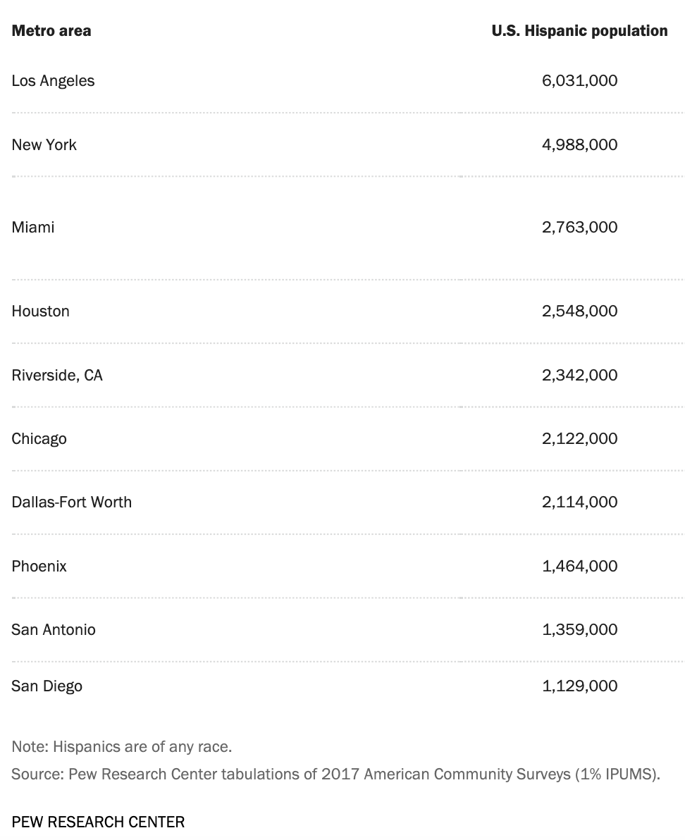
U.S. Cities with Highest Latino (Hispanic) Population
Source: Pewresearch.org (https://www.pewresearch.org/hispanic/fact-sheet/latinos-in-the-u-s-fact-sheet/)

Slide 14
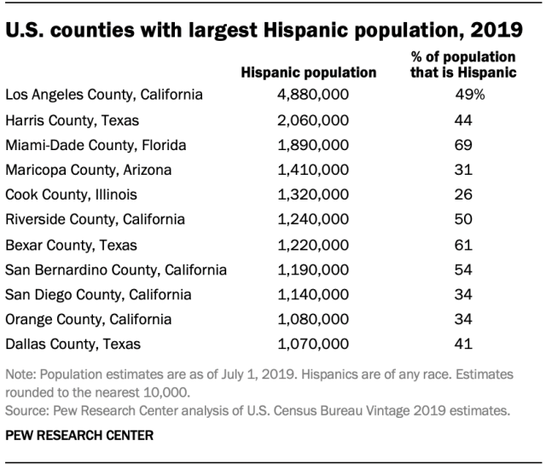
U.S. Counties with Highest Latino (Hispani) Population
Source: Pewresearch.org (https://www.pewresearch.org/hispanic/fact-sheet/latinos-in-the-u-s-fact-sheet/)

Slide 15
Common Misconceptions we’ve heard from students:
Latinx students speak and/or understand Spanish
history of denial of language, assimilationist practices
Importance of recognizing and encouraging language as an asset and not a deficiency
Latinx students are of Mexican descent:
At nearly 37 million, Mexicans are the largest origin group and make up 62% of Latinos, but this share has decreased from a recent peak of 66% in 2008. The Mexican population grew by 11% from 2010 to 2017, tied for the lowest growth rate among top 15 origin groups.
Venezuelans, Dominicans and Guatemalans saw the fastest population growth since 2010.
At SDSU: invisibilization of Central American, South American students as well as Indigenous students (double erasure, ethnicity and language)
Latinx students have a recent migration history:
“ Nearly four-in-five Latino immigrants (78%) have lived in the U.S. for more than 10 years, up from 64% in 2010. Panamanian (88%) and Mexican (84%) immigrants have the highest shares on this measure. Many Latino immigrants have been in the U.S. for decades – 46% of Latino immigrants have lived in the U.S. for 21 or more years.”
(Source: https://www.pewresearch.org/fact-tank/2019/09/16/key-facts-about-u-s-hispanics)

Slide 16
Latinx students have a recent migration history:
“ Nearly four-in-five Latino immigrants (78%) have lived in the U.S. for more than 10 years, up from 64% in 2010. Panamanian (88%) and Mexican (84%) immigrants have the highest shares on this measure. Many Latino immigrants have been in the U.S. for decades – 46% of Latino immigrants have lived in the U.S. for 21 or more years.”
Additionally, Latina/os connect their heritage to living in US for several generations,
(Source: https://www.pewresearch.org/fact-tank/2019/09/16/key-facts-about-u-s-hispanics)

Slide 17
Proactive steps for faculty and staff:
Engage your students, get to know them, their backgrounds who they are
Recognize their intersectional identities
Be attentive to how students identify themselves or ask them how they prefer to be culturally identified
Make an attempt to pronounce their names correctly.
Be aware of your implicit biases when engaging Latinx students. How do these show up in the way you perceive, teach, engage them? How do microaggressions impact students ability to succeed academically?

Slide 18
Noted Sources
“About One-in-Four U.S. Hispanics Have Heard of Latinx, but Just 3% Use It”. August, 2020. Pew Research Center
“Key facts about U.S. Hispanics and their diverse heritage”. September, 2019. Pew Research Center
“What’s in a name? How the concepts of Hispanic and Latino identity emerged”. 2019. UC Newsroom
Additional Sources
SDSU:
Center for Inclusive Excellence: https://sacd.sdsu.edu/cie
Office of HSI Affairs: https://sacd.sdsu.edu/diversity-initiatives/hsi-affairs
HSI Identity Task Force Report: https://sacd.sdsu.edu/diversity-initiatives/_resources/docs/hsi-report-april-2020.pdf
Hernández, R. J., & Villodas, M. T. (2020). Overcoming racial battle fatigue: The associations between racial microaggressions, coping, and mental health among Chicana/o and Latina/o college students. Cultural Diversity and Ethnic Minority Psychology, 26(3), 399–411. https://doi.org/10.1037/cdp0000306
“San Diego Mexican and Chicano History”. Richard Griswold del Castillo. https://chicanohistory.sdsu.edu/chapter10/c10s02.html
“The X In Latinx Is A Wound, Not A Trend”. Alan Pelaez Lopez. ColorBloq. https://www.colorbloq.org/the-x-in-latinx-is-a-wound-not-a-trend

Slide 19
Learn more about the Latinx Resource Center and stay up to date with our ongoing programs and events:
Visit the LRC Website: https://sacd.sdsu.edu/latinx-resource
Follow the LRC on Instagram and Facebook: @SDSULRC
Sign up for the LRC Newsletter: bit.ly/LRCNEWSLETTER
Yesenia Sanchez, LRC Director: ysanchezgarcia@sdsu.edu

